Slide 1

CS 422: UI Design and Programming
Final Review

Slide 2
Upcoming
GR6, AS3, an RS3 are due today.
Final exam will be held on Wednesday, May 8, 3:45 – 4:45pm, LC6
Arrive 10 minutes early and settle down.
Bring your laptops to the exam.

Slide 3
Final exam
Open notes
Open web; beware of the Internet, not everything you see there is correct
60 minutes; we will start at 3:45pm sharp.
Exam will be provided online on Blackboard. A word document with questions will be provided. Download it, write your answers, and then upload it on BB.
A mix of MCQ and short open-ended, problem-solving questions
Syllabus: Comprehensive, everything covered in class.

Slide 4
Finals Review

Slide 5
Thigs we have learned
Usability dimensions
Learnability
Efficiency
Safety
Accessibility
UI prototyping
User-centered design
Prototyping
UI software architecture
Input
Output
Visual design
Graphic Design
Layout
User testing
Intro to user testing
Heuristic evaluation

Slide 6
Thigs we have learned
Usability dimensions
Learnability
Efficiency
Safety
Accessibility
UI prototyping
User-centered design
Prototyping
UI software architecture
Input
Output
Visual design
Graphic Design
Layout
User testing
Intro to user testing
Heuristic evaluation

Slide 7

Usability
Q: Why might users find this UI problematic?
A: “It’s a usability problem.”

Slide 8

Dig deeper than “a usability problem”
Ask is this a learnability, efficiency, or safety problem?
But don’t stop there.
Why is this a learnability, efficiency, or safety problem?

Slide 9
Three frameworks to think about usability
Learnability, efficiency, and safety.
Nielsen’s 10 heuristics
Norman’s rules from Design of Everyday Things

Slide 10
Usability concerns with the system model.
True
False

Slide 11
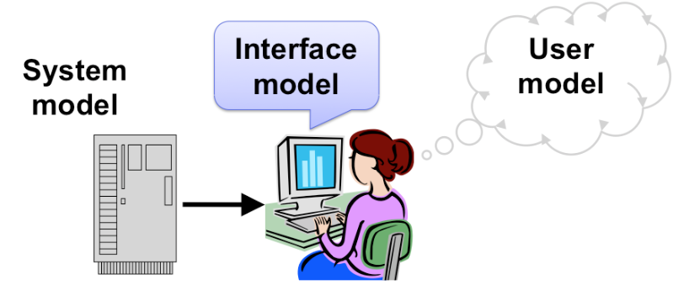
Usability concerns with the system model.
True
False

Slide 12
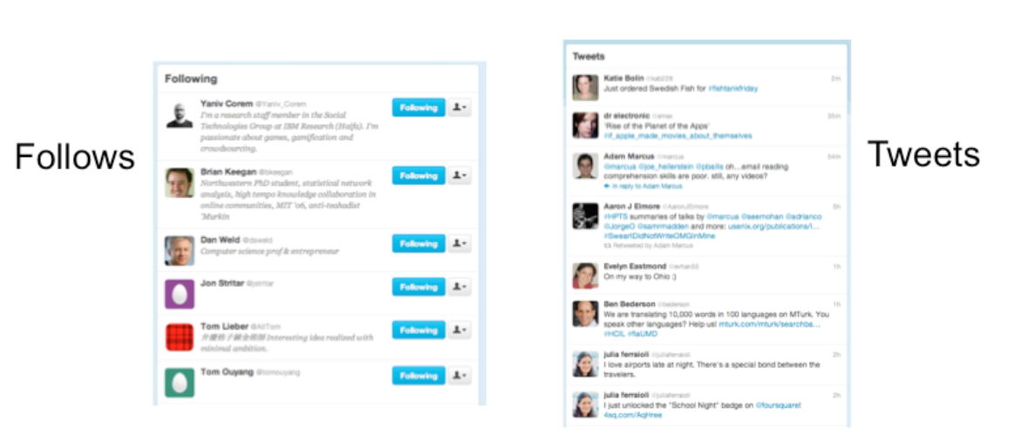
Conceptual Model
Model of a system = how the system works
Model of the user = how the user thinks the system works
Notes:
For example, at a high level, the model of Twitter is that there are other users in the system, you have a list of people that you follow and a list of people that follow you, and each user generates a stream of tweets that are seen by their followers, mixed together into a feed. These are all the parts of the system. At a more detailed level, tweets and people have attributes and data, and there are actions that you can do in the system (viewing tweets, creating tweets, following or unfollowing, etc.). These data items and actions are also parts of the model.

Slide 13
Let’s look at an application. What’s the conceptual model here?
What is TikTok?
Notes:
https://www.commonsensemedia.org/blog/parents-ultimate-guide-to-musically

Slide 14
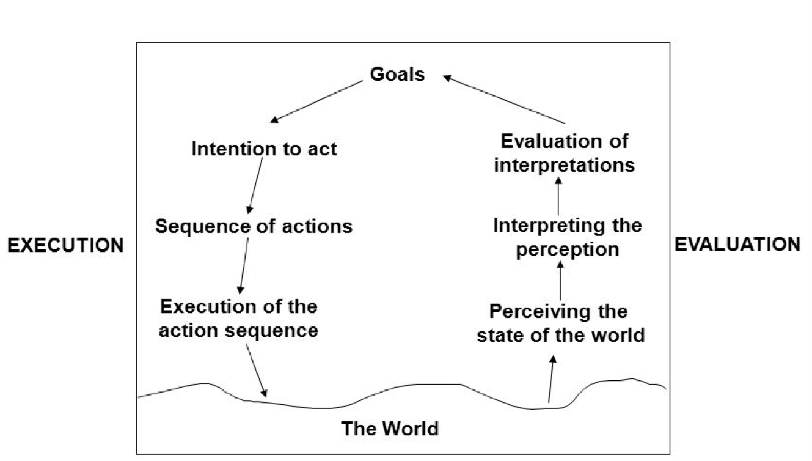
Norman's seven stages of action.
There is often a gap between how a system is built to operate, and how users under stand how it operates.

Slide 15
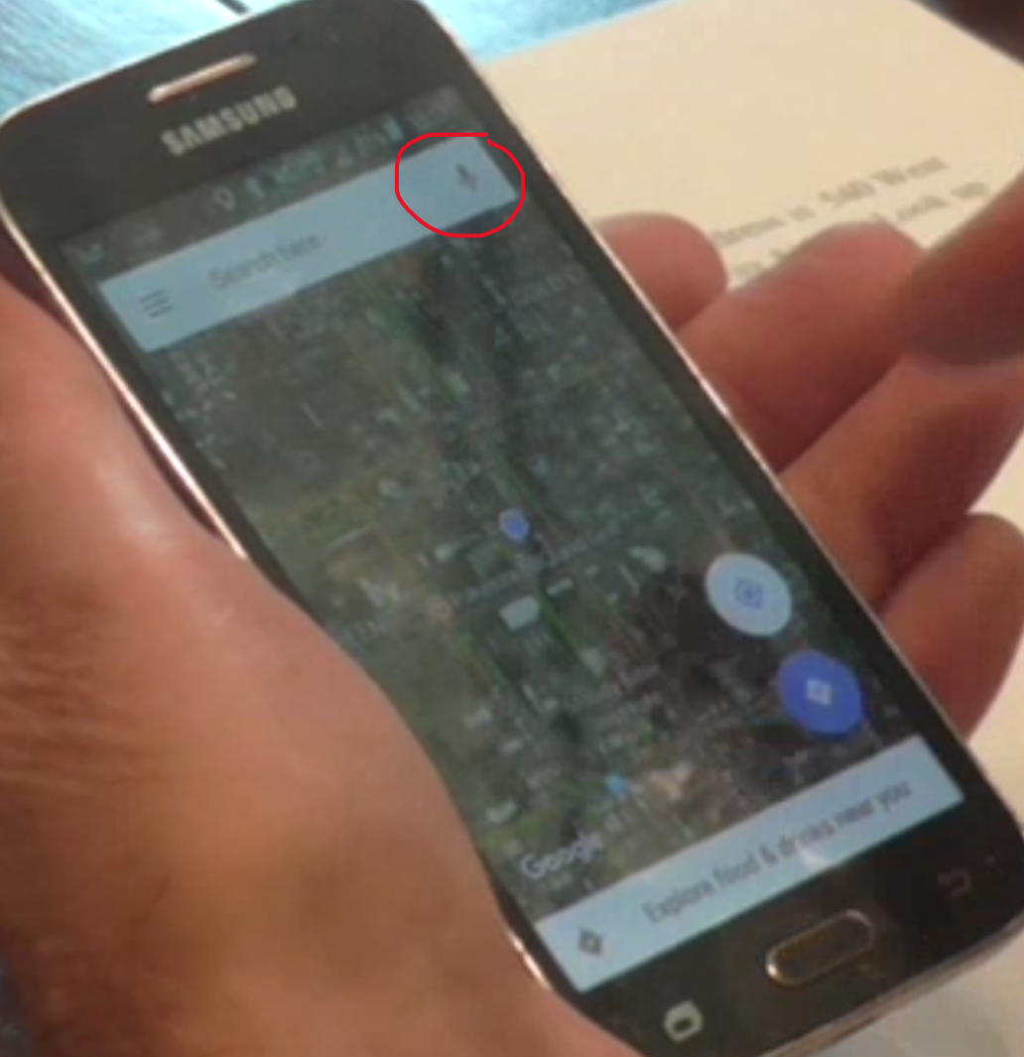
Consider this: What’s the usability issue according to Norman?
Jim was staring at the home page trying to figure out where to input an address in the map app. After a while, he opened up the voice prompt and said, “How do I put an address in this?”
Gulf of execution
Gulf of evaluation

Slide 16
Consider this: What’s the usability issue according to Norman?
Jim was staring at the home page trying to figure out where to input an address in the map app. After a while, he opened up the voice prompt and said, “How do I put an address in this?”
Gulf of execution
Gulf of evaluation

Slide 17
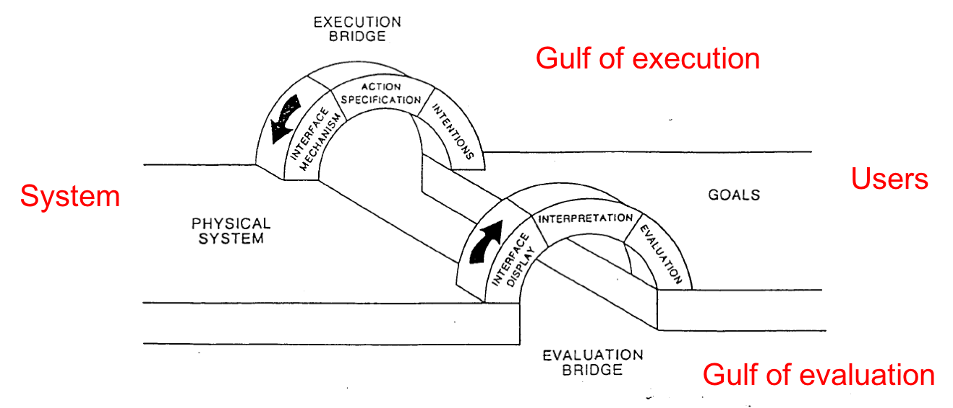

Slide 18
Comparison of Interaction Styles
Usability | command language | menus and forms | direct manipulation | speech dialog
Learnability | requires significant learning | much more information into the world | information in the world via metaphors | requires knowing what to say
Error messages | needs error messages | needs error messages | rarely needs error messages | needs error messages
Efficiency | experts can be very efficient | demands good shortcuts | learnability over efficiency | Experts can be very efficient
User type | expert users | better for novices and infrequent users
Synchrony | synchronous | synchronous | asynchronous | synchronous
Notes:
first the user types a complete command, then the system does it. DM, on the other hand, is asynchronous: the user can point the mouse anywhere and do anything at any time. DM interfaces are necessarily event driven.

Slide 19
Needfinding is most relevant for which model(s) of UI design?
System model
Interface model
User model
All of the above

Slide 20
Needfinding is most relevant for which model(s) of UI design?
System model
Interface model
User model
All of the above

Slide 21
Prototyping is most relevant for which model(s) of UI design?
System model
Interface model
User model
All of the above

Slide 22
Prototyping is most relevant for which model(s) of UI design?
System model
Interface model
User model
All of the above

Slide 23
Consistency
Similar things should look and act the same
Different things should look different
also called the principle of “least surprise”
Consistency allows the user to transfer their existing knowledge easily to a new UI

Slide 24
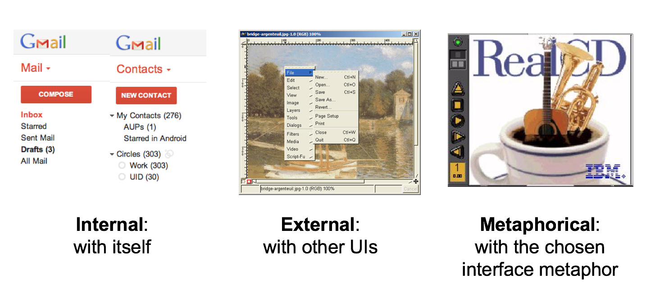
Kinds of Consistency

Slide 25
Internal Consistency in Wording
Another important kind of consistency, often overlooked, is in wording. Use the same terms throughout your user interface.
If your interface says “share price” in one place, “stock price” in another, and “stock quote” in a third, users will wonder whether these are three different things you’re talking about.

Slide 26
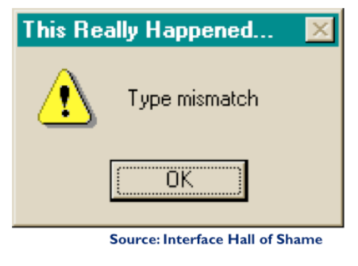
External Consistency in Wording: Speak the User’s Language
Use common words, not techie jargon
But use domain-specific terms where appropriate
Allow aliases/synonyms in command languages
Notes:
How might a user interpret the dialog box shown here? One poor user read “type” as a verb, and dutifully typed M-I-S-M-A-T-C-H every time this dialog appeared. The user’s reaction makes perfect sense when you remember that most computer users do just that, type, all day. But most programmers wouldn’t even think of reading the message that way. Yet another example showing that you are not the user.

Slide 27
Affordances
Affordance refers to the perceived and actual properties of a thing, primarily the properties that determine how the thing could be operated.
Chairs have properties that make them suitable for sitting;
doorknobs are the right size and shape for a hand to grasp and turn.
A button’s properties say “push me with your finger.”
Scrollbars say that they continuously scroll or pan something that you can’t entirely see. Affordances are how an interface communicates nonverbally, telling you how to operate it.

Slide 28
A hamburger menu should open up less frequently used functions in your app, not used to do other things. Why?
Metaphor
Internal Consistency
External Consistency
Affordance

Slide 29
A hamburger menu should open up less frequently used functions in your app, not used to do other things. Why?
Metaphor
Internal Consistency
External Consistency
Affordance

Slide 30
If a user does not perceive a clickable button as a button. What is the usability issue?
Metaphor
Internal Consistency
External Consistency
Affordance

Slide 31
A user does not perceive a clickable button as a button. What is the usability issue?
Metaphor
Internal Consistency
External Consistency
Affordance

Slide 32
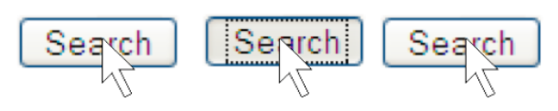
Feedback
Actions Should Have Immediately Visible Effects
Low-level feedback
e.g. push button
High-level feedback
model state changes
new web page starts loading

Slide 33
Affordances and Feedback
Hand-in-hand with affordances is feedback: how the system changes visibly when you perform an action.
Recall perceptual fusion: Two events occurring less than the cycle time apart are likely to appear in the same frame.
Perceptual fusion also gives an upper bound on good computer response time.
If a computer responds to a user’s action within T_p time, its response feels instantaneous with the action itself.
Systems with that kind of response time tend to feel like extensions of the user’s body. If you used a text editor that took longer than T_p response time to display each keystroke, you would notice.

Slide 34
What best describes heuristic evaluation?
Formative evaluation
Summative evaluation
None of the above

Slide 35
What best describes heuristic evaluation?
Formative evaluation
Summative evaluation
None of the above

Slide 36
Heuristic evaluations are mostly used as a formative evaluation
Heuristic evaluations should be done during the design and development, to quickly find usability issues and address them.
The most suitable kind of summative evaluation is user testing with real users, preferably in real use contexts.

Slide 37
Nielsen’s 10 Heuristics
Match the real world (L)
Consistency & standards (L)
Help & documentation (L)
User control & freedom (S)
Visibility of system status (S)
Flexibility & efficiency (E)
Error prevention (S)
Recognition, not recall (S)
Error reporting, diagnosis, and recovery (S)
Aesthetic AND minimalist design

Slide 38
What is the main difference between heuristic evaluation and user testing?
Assessing usability
Real users testing the UI
All of the above

Slide 39
What is the main difference between heuristic evaluation and user testing?
Assessing usability
Real users testing the UI
All of the above
Evaluator is not the user!

Slide 40
Heuristic Evaluation Is Not User Testing
Evaluator is not the user either
Maybe closer to being a typical user than you are, though
Analogy: code inspection vs. testing
HE finds problems that UT often misses
Inconsistent fonts
Fitts’s Law problems
But UT is the gold standard for usability

Slide 41
Shortcuts improve efficiency
Keyboard shortcuts provide accessibility benefits to visually impaired users or motor-impaired users (can’t use mouse well due to physical limitations)

Slide 42
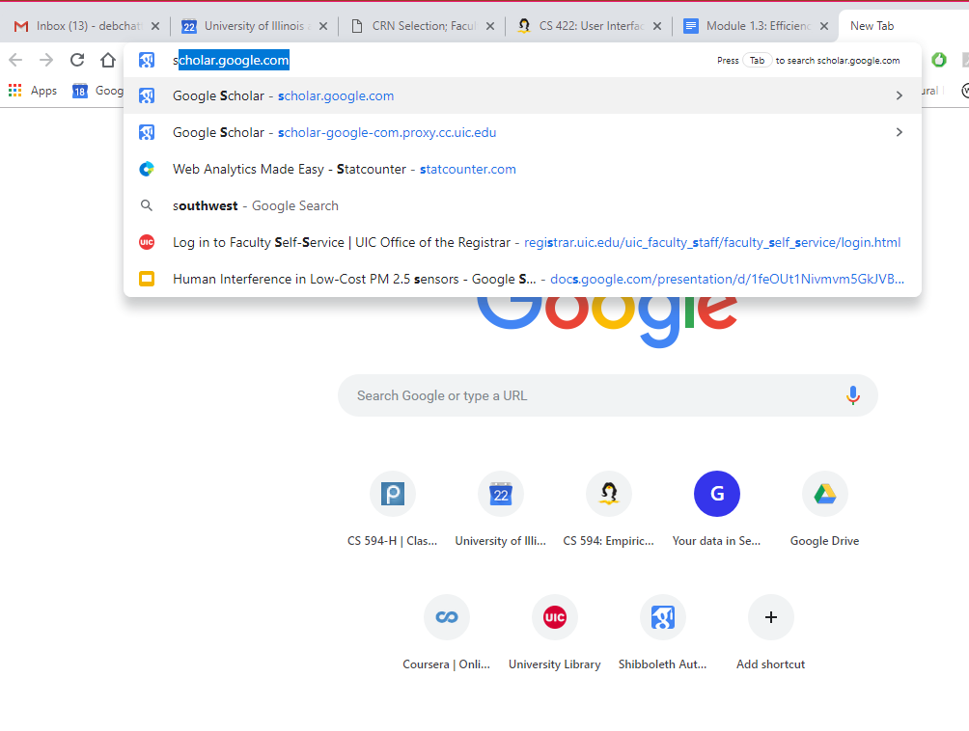
Defaults & Pending Delete
Fill in a form with defaults
from history, by prediction
Make the defaults fragile (pending delete mechanism)
Notes:
Defaults should be fragile; when you click on or Tab to a field containing a default value, it should be fully selected so that frequent users can replace it immediately by simply starting to type a new value. (This technique, where typing replaces the selection, is called pending delete.

Slide 43
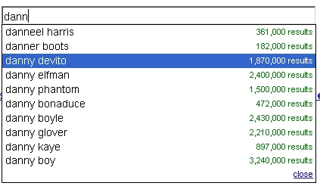
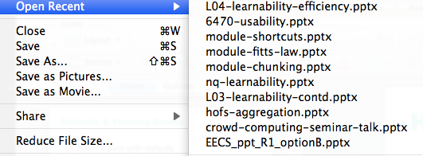
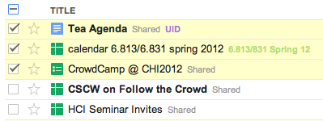
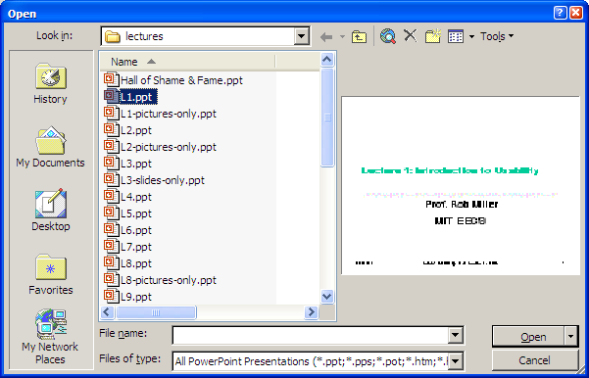
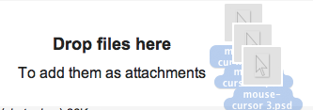
Other form of shortcuts
History
Autocomplete
Anticipation
Aggregation

Slide 44
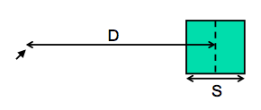
Fitts’s Law
Time T to move your hand to a target of size S at distance D away is:
T = RT + MT = a + b log (D/S + 1)
It’s a fundamental law of the human sensory-motor system, which has been replicated by numerous studies.

Slide 45
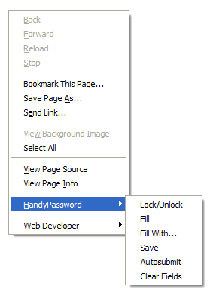
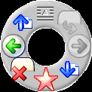
Implications of Fitts’s Law
Targets at screen edge are easy to hit
Mac menu bar beats Windows menu bar
Unclickable margins are foolish
According to one study, pie menus are 15-20% faster than linear menus (Callahan et al. “An empirical comparison of pie vs. linear menus,” CHI 1991).

Slide 46
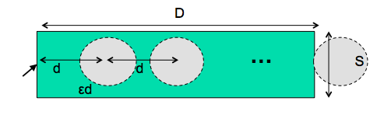
Steering Task
Index of difficulty is now linear, not logarithmic
So steering is much harder than pointing
Thus cascading submenus are hard to use
It takes exponentially longer to hit a menu item on a cascading submenu than it would if you weren’t constrained to move down the tunnel to it.
The Mac gets a Hall of Fame nod here:
when a submenu opens, it provides an invisible triangular zone, spreading from the mouse to the submenu, in which the mouse pointer can move without losing the submenu.

Slide 47
Fitts’s law best applies to modeling what kind of cognitive processing
Skill-based
Rule-based
Knowledge-based

Slide 48
Fitts’s law best applies to modeling what kind of cognitive processing
Skill-based
Rule-based
Knowledge-based

Slide 49
Fitts’s law for pointing applies to:
A. Open loop motor control
B. Closed loop motor control
Notes:
http://pages.mtu.edu/~rpastel/Research/Documents/p295-accot.pdf

Slide 50
Fitts’s law for pointing applies to:
A. Open loop motor control
B. Closed loop motor control
Moving your hand to a target is closed-loop control

Slide 51
Predictive Evaluation
Predictive evaluation uses an engineering model of human cognition to predict usability
In this case, we’ll predict efficiency
The engineering model is
abstract
quantitative
approximate
estimated from user experiments
Notes:
At its heart, any predictive evaluation technique requires a model for how a user interacts with an interface. This model needs to be abstract – it can’t be as detailed as an actual human being (with billions of neurons, muscles, and sensory cells), because it wouldn’t be practical to use for prediction.
Where do the parameters come from? They’re estimated from experiments with real users.

Slide 52
Advantages of Predictive Evaluation
Don’t have to build UI prototype
Can compare design alternatives with no implementation whatsoever
Don’t have to test real live users
Theory provides explanations of UI problems
So it points to the areas where design can be improved
User testing may only reveal problems, not explain them

Slide 53
Keystroke level model
The first predictive model was the keystroke level model (proposed by Card, Moran & Newell, “The Keystroke Level Model for User Performance Time with Interactive Systems”, CACM, v23 n7, July 1978).
This model seeks to predict efficiency (time taken by expert users doing routine tasks) by breaking down the user’s behavior into a sequence of the five primitive operators shown here.
K eystroke
B utton press or release with mouse
P oint with mouse
D raw line with mouse
H ome hands between mouse and keyboard
M entally prepare
Notes:
Most of the operators are physical–the user is actually moving their muscles to perform them. The M operator is different–it’s purely mental (which is somewhat problematic, because it’s hard to observe and estimate). The M operator stands in for any mental operations that the user does. M operators separate the task into chunks, or steps, and represent the time needed for the user to recall the next step from long-term memory.

Slide 54
KLM Analysis
Encode a method as a sequence of physical operators (KPHD)
Use heuristic rules to insert mental operators (M)
Add up times for each operator to get total time for method

Slide 55
What might be a limitation of KLM?
Models only novice users’ performance
Models efficiency exclusively
All of the above

Slide 56
What might be a limitation of KLM?
Models only novice users’ performance
Models efficiency exclusively
All of the above

Slide 57
Limitations of KLM
Only expert users doing routine (well-learned) tasks
Only measures efficiency
Not learnability or safety
Ignores
errors (methods must be error-free)
parallel action (shift-click); assumes that all actions are serialized
mental workload (e.g. attention & WM limits)
planning & problem solving (how does user select the method?)
fatigue
Notes:
KLM also assumes that all actions are serialized, even actions that involve different hands (like moving the mouse and pressing down the Shift key). Real experts don’t behave that way; they overlap operations.

Slide 58
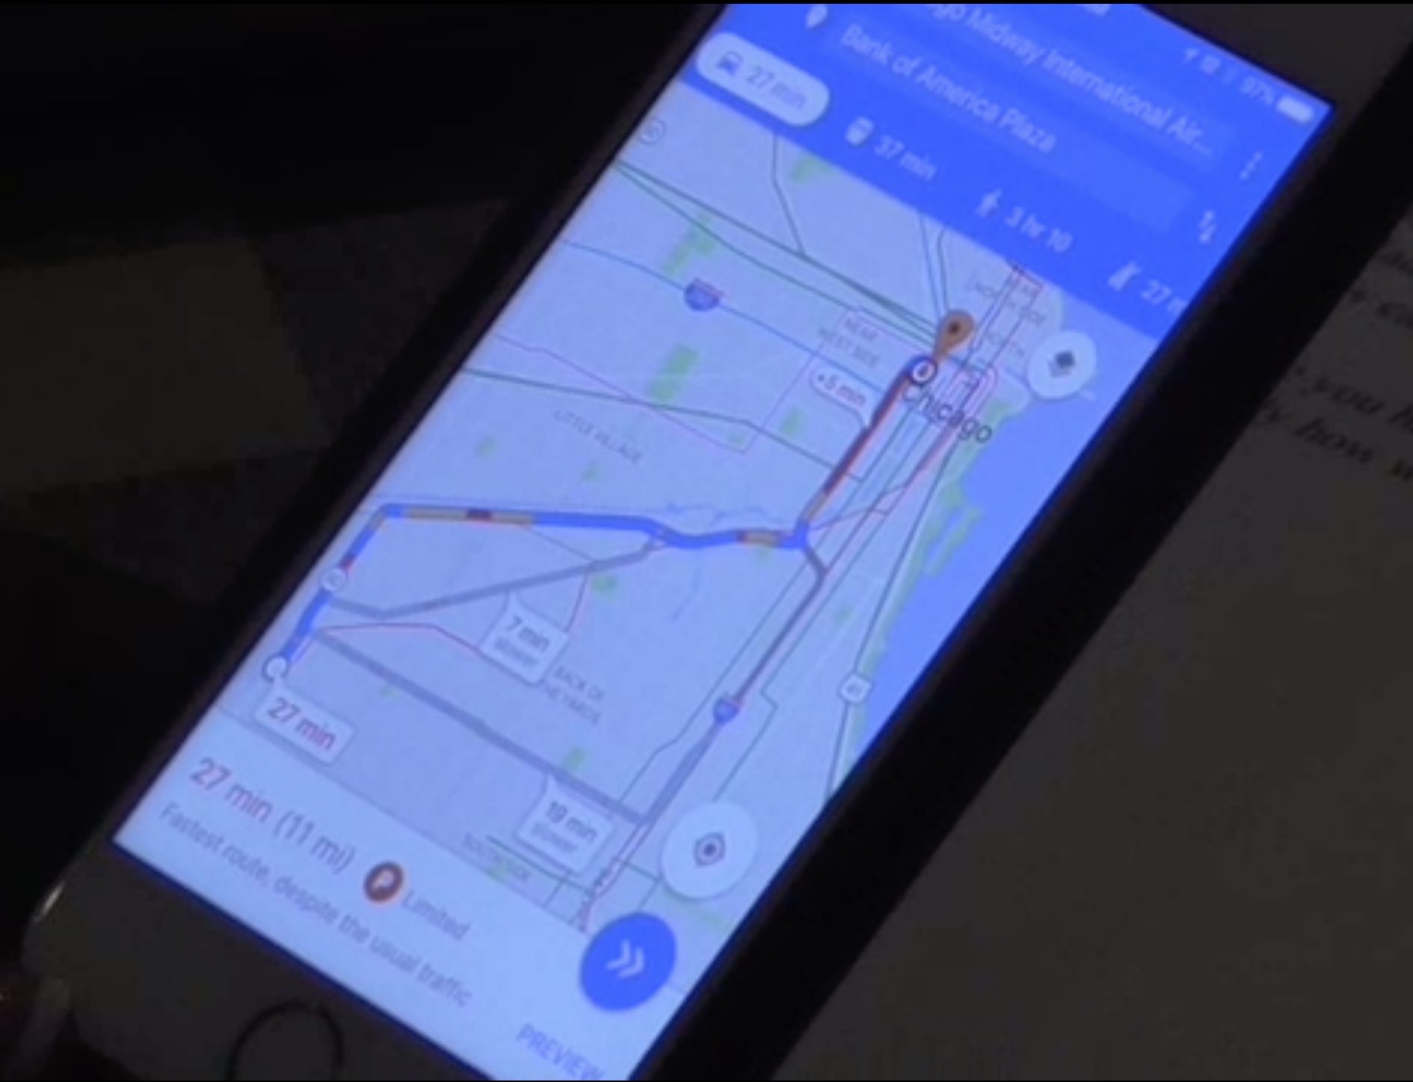
Consider this.
Tom opens up the home page and uses the microphone icon to input “540 West Madison from Midway airport, public transportation”. Then looks at the map and says “I don’t see the buses.” Tries 5 times. What’s the issue?
Capture error
Mode error
Description error
Mistake

Slide 59
Consider this.
Tom opens up the home page and uses the microphone icon to input “540 West Madison from Midway airport, public transportation”. Then looks at the map and says “I don’t see the buses.” Tries 5 times. What’s the issue?
Capture error
Mode error
Description error
Mistake

Slide 60
Types of human errors
Slip
Lapse
Mistake

Slide 61
During taking an action, humans may do an error
Human error ≠ System error
Even if an interface is easy to learn and quick to use, it may produce more errors than intended. Hence we need to concern ourselves with safety of a UI.

Slide 62
Slip
Slip is a failure of execution
Failure to correctly execute a procedure
Typically found in skilled behavior

Slide 63
Mistake
A mistake is an error made in planning or rule application.
One way of classifying cognitive behavior is into:
skill-based (learned procedures),
rule-based (application of learned if-then rules),
and knowledge-based (problem solving, logic, experimentation, etc.)
Mistakes are errors in rule-based or knowledge-based behavior

Slide 64
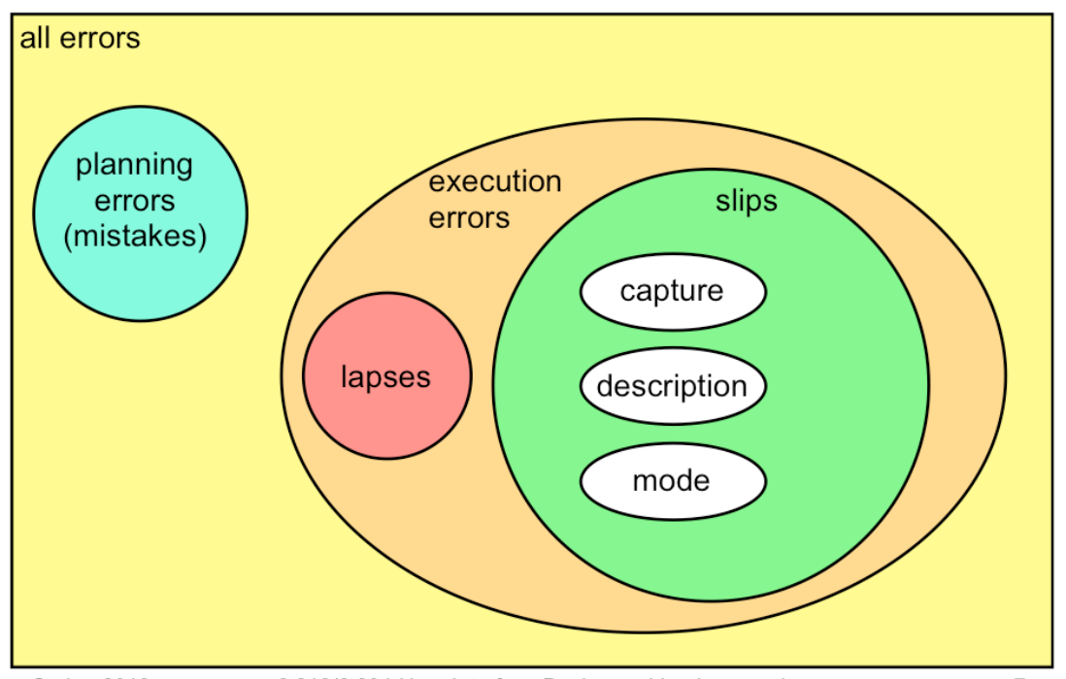
Digging deeper into error types

Slide 65
Different kinds of slips
Capture error
Description error
Mode error

Slide 66
Capture Error
A capture slip occurs when a person starts executing one sequence of actions, but then veers off into another (usually more familiar) sequence that happened to start the same way.
E.g., driving to school instead of to the dentist
E.g., if a user intends just to save the file (:w) but accidentally quits as well (:wq), then they’ve committed a capture error.
A good mental picture for this is that you’ve developed a mental groove from executing the same sequence of actions repeatedly, and this groove tends to capture other sequences that start the same way.

Slide 67
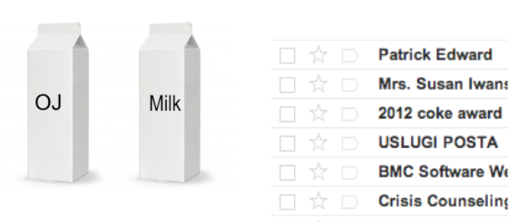
Description error
A description slip occurs when two actions are very similar (NOT the result of the actions). The user intends to do one action, but accidentally substitutes the other.
Consistency (same) is good for learning
Inadvertent similarity (close but not quite) is bad for safety

Slide 68
Mode error
Modes are states in which the same action has different meanings.
For example, when Caps Lock mode is enabled on a keyboard, the letter keys produce uppercase letters.
The text editor vi is famous for its modes: in insert mode, letter keys are inserted into your text file, while in command mode (the default), the letter keys invoke editing commands.
Mode errors are generally slips, an error in the execution of a learned procedure, caused by failing to correctly evaluate the state of the interface.

Slide 69
Causes of execution errors
Inattention or inappropriate attention
omission or distraction of attention at a key moment.
strong-but-wrong behavior.
the particular erroneous behavior chosen is often selected because of its high similarity to the correct behavior (as in capture and description slips), or of its high frequency relative to the correct behavior (as in capture slips). Very common, or very similar, patterns are strongly available for retrieval from human memory. (think elaborate rehearsal)
speed-accuracy tradeoff
We can force ourselves to make decisions faster (shorter reaction time) at the cost of making some of those decisions wrong.

Slide 70
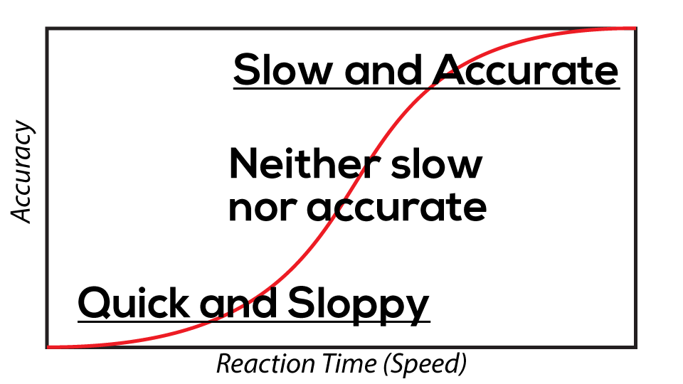
Efficiency can be traded off against safety
Notes:
https://en.wikipedia.org/wiki/Logistic_function

Slide 71
Why are the options to change transport mode adjacent to the map view?
Shortcut
Metaphor
Locus of attention

Slide 72
Why are the options to change transport mode adjacent to the map view?
Shortcut
Metaphor
Locus of attention

Slide 73
Locus of Attention
Feedback Visibility Depends on Locus of Attention
Spotlight of attention: attention focuses on one input channel (e.g. area of visual field) at a time
Does the user’s locus of attention include:
Caps Lock light on keyboard?
Status bar?
Menu bar?
Mouse cursor?

Slide 74
Locus of Attention
So when you’re thinking about how to make something important visible, you should think about where the user’s attention is likely to be focused – their document? The text cursor? The animated banner ads on the web site?
Users who use keyboard shortcuts heavily may make mode errors – in this case, sending a keyboard command to the wrong application – because they aren’t attending to the state of the menu bar.

Slide 75
Information Scent
Information foraging theory claims that we ask similar questions when we’re collecting information: Where should I search? Which articles or paragraphs are worth reading? Have I exhausted this source, should I move on to the next search result or a different search?
Users depend on visible cues to figure out how to achieve their goals with the least effort.

Slide 76
Give Good Information Scent
A link should “smell” like the content it leads to.
Hyperlinks in your interface – or in general, any kind of feature, including menu commands and toolbar buttons – should provide good, appropriate information scent.

Slide 77
Hierarchy of Exploration Costs
Glance
affordances, icons, short salient words
Read
description, keywords
Hover or press
cursor change, highlight, tooltip, submenu, preview
Click through
target page, dialog box, or mode
Invoke
feedback effect on the model state
Notes:
For the user, collecting information scent cues is done progressively, with steadily increasing cost.

Slide 78

Remember to submit your course evaluations
2% extra credit.
Send submission confirmation to Nina.
Deadline: Sunday, May 5th
Will help me and your future peers a lot!

Slide 79
Good luck for the finals!

